Slide 1
Micro Credit Defaulter Project
Created By
Jayashri Dandare

Slide 2
Introduction

Slide 3
Business Problem Framing
A Microfinance Institution (MFI) is an organization that offers financial services to low income populations. MFS becomes very useful when targeting especially the unbanked poor families living in remote areas with not much sources of income. The Microfinance services (MFS) provided by MFI are Group Loans, Agricultural Loans, Individual Business Loans and so on.
Many microfinance institutions (MFI), experts and donors are supporting the idea of using mobile financial services (MFS) which they feel are more convenient and efficient, and cost saving, than the traditional high-touch model used since long for the purpose of delivering microfinance services. Though, the MFI industry is primarily focusing on low income families and are very useful in such areas, the implementation of MFS has been uneven with both significant challenges and successes.
Today, microfinance is widely accepted as a poverty-reduction tool, representing $70 billion in outstanding loans and a global outreach of 200 million clients.

Slide 4
Project goal
Analytical Problem Framing
EDA
Visualizations
Data Pre-processing on Train & test dataset
Model development and Evaluation
Performing Hyper-parameter Tuning
Best Fit Model and prediction
Conclusion

Slide 5
Exploratory Data Analysis (EDA)
This section shows the exploration done on the dataset, which is what motivated the use of the algorithm.
A significant relationship between Non-defaulter & defaulter.
Dataset is imbalanced. Label ‘1’ has approximately 87.5% records, while, label ‘0’ has approximately 12.5% records.
Training phase: The system is trained by using the data set and fits a model.
Testing phase: The system is provided with the inputs and is tested for its working. The accuracy is checked.

Slide 6
EDA Steps:
Data Visualization
Statistical summary
To check Correlation
Univariate Analysis
Bivariate Analysis

Slide 7
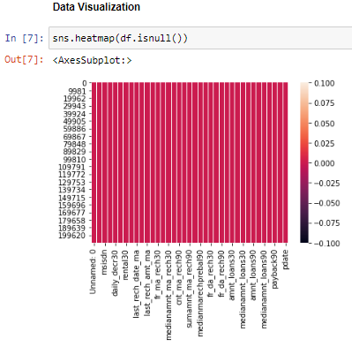
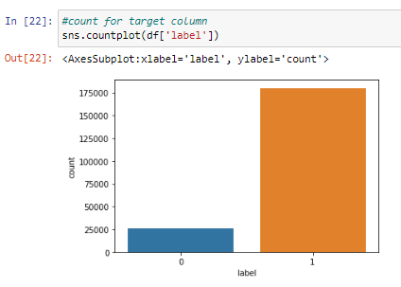
Data Visualization

Slide 8
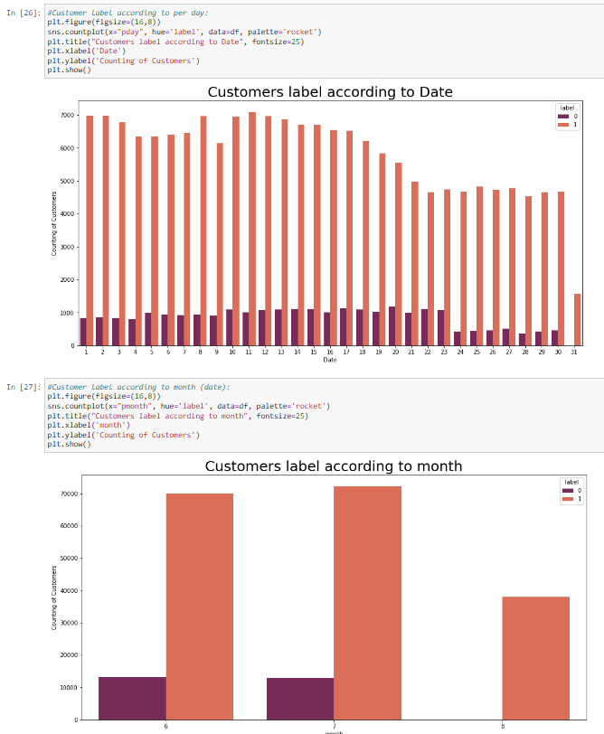
Loan count as per date and month

Slide 9
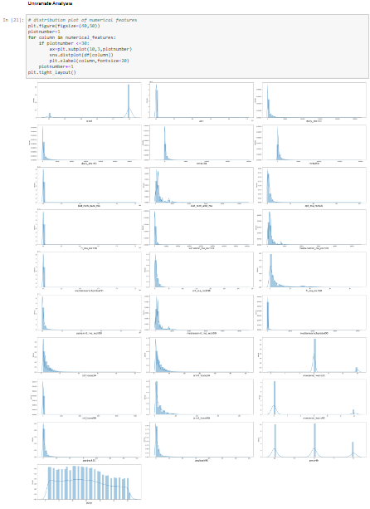
Multivariate Analysis
Distribution plot to check through all the column details ensuring that the distribution is displayed for further analysis

Slide 10
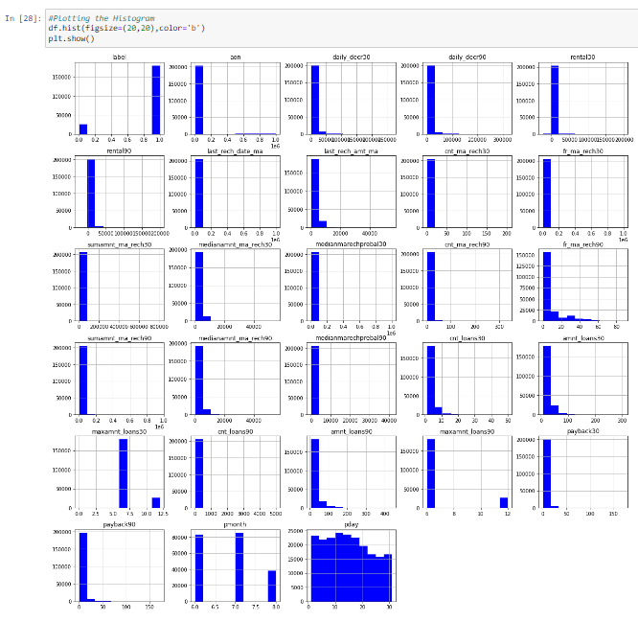
Plotting the Histogram

Slide 11
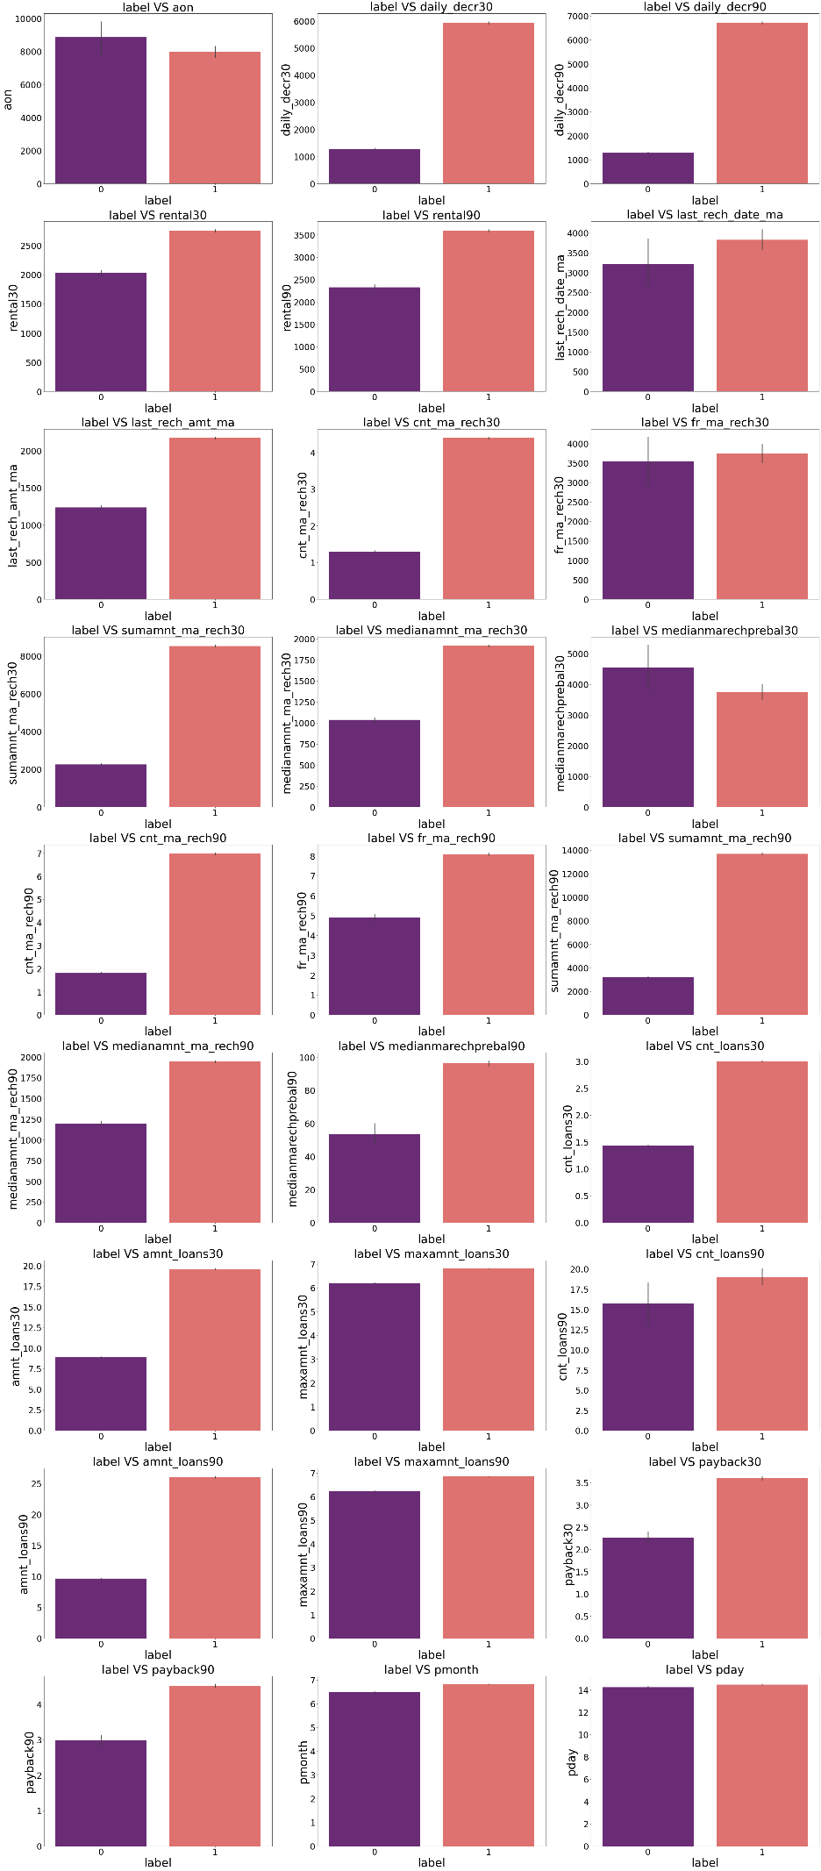
Bivariate Analysis
With the help of Bar Plot we are able to see the success and failure label data for the columns basically the feature data.

Slide 12
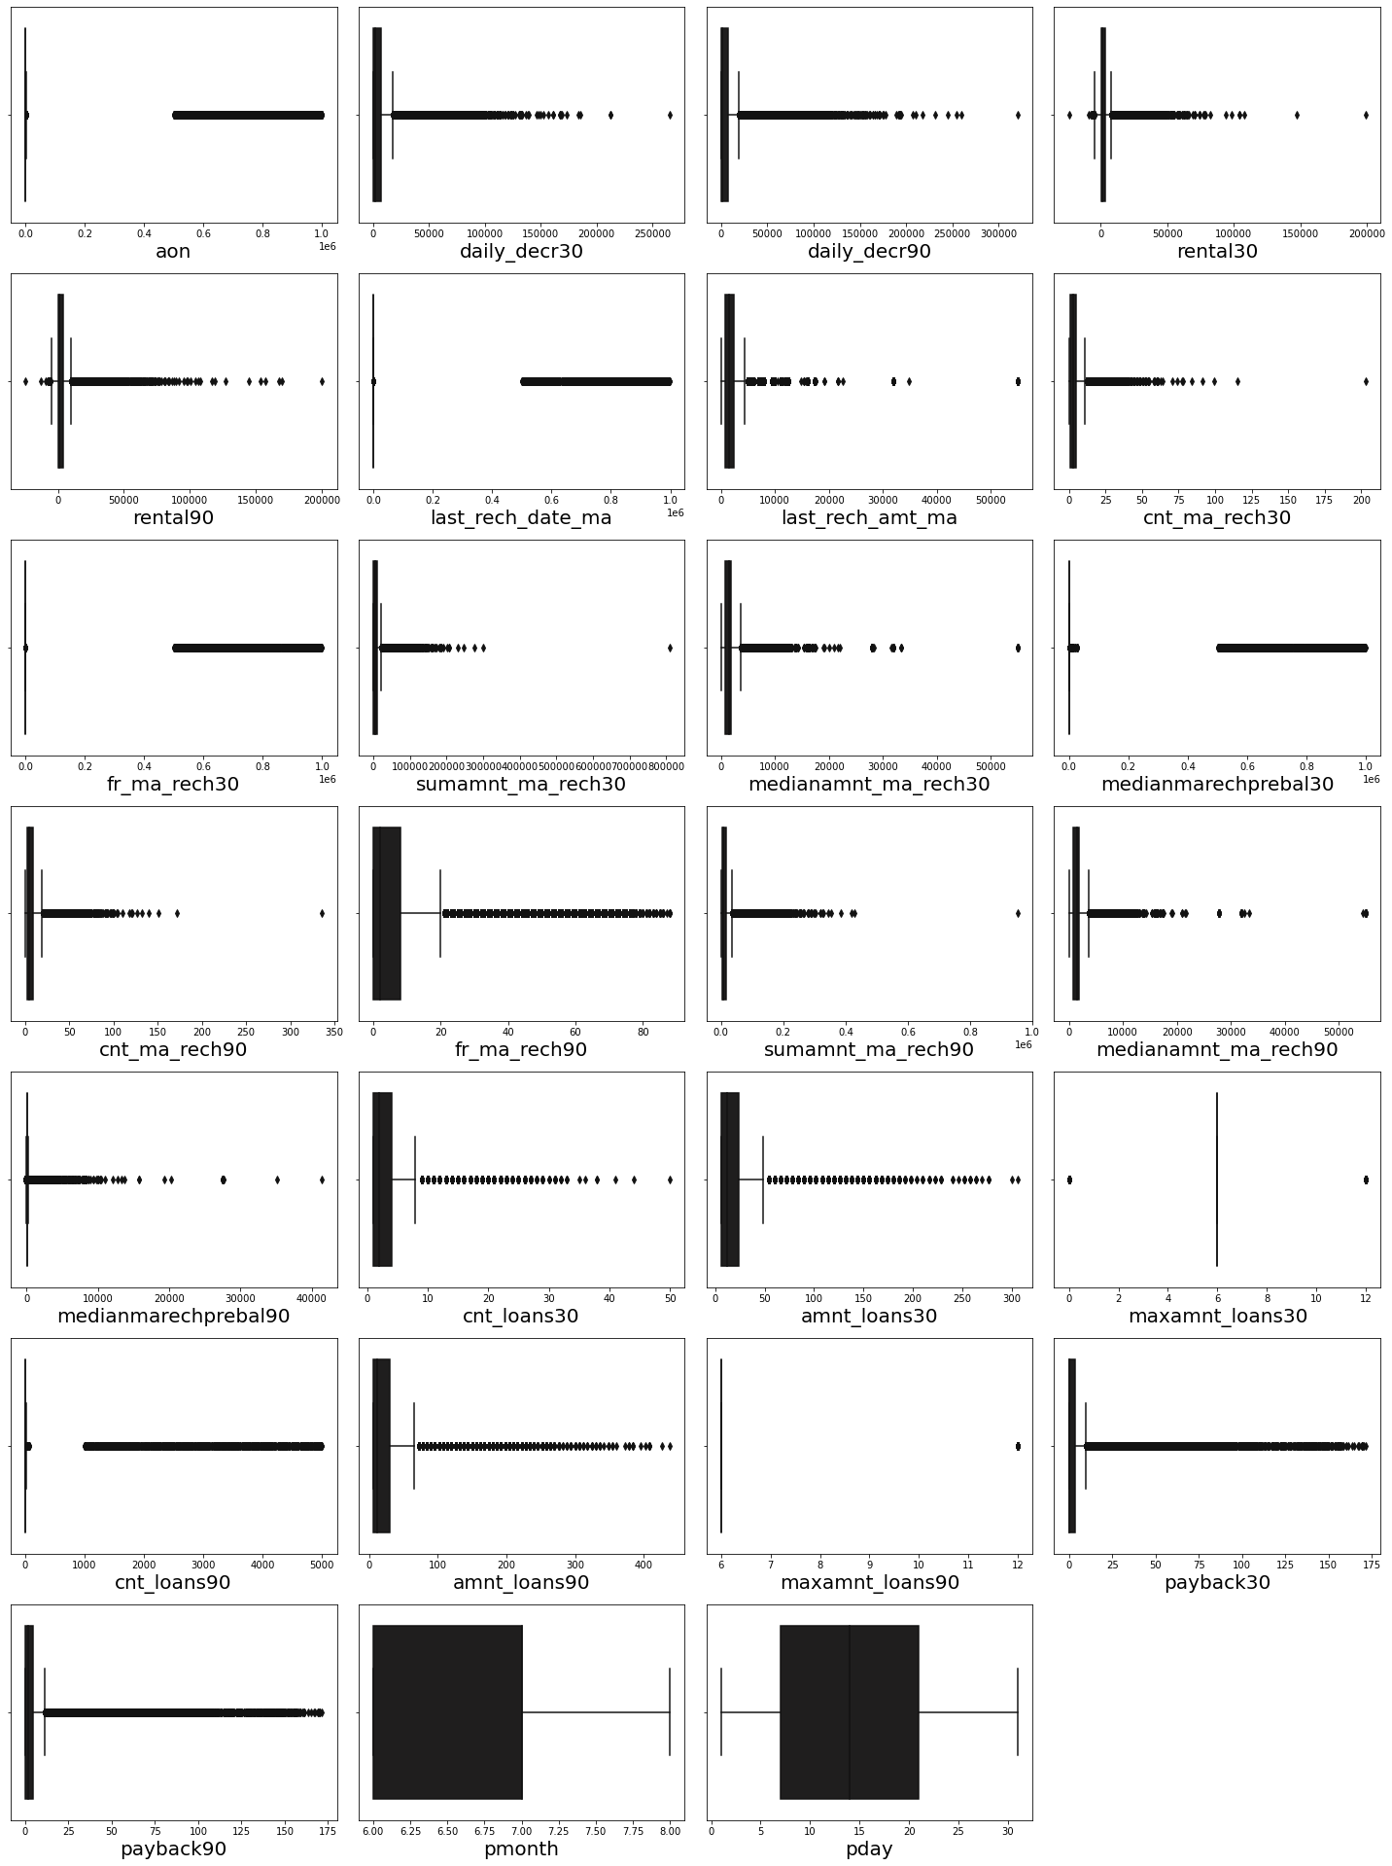
Statistical representation of the all the numeric data columns.
In that have outliers so treat them with different methods

Slide 13
Model building
Built model which can be used to predict in terms of a probability for each loan transaction, whether the customer will be paying back the loaned amount within 5 days of insurance of loan.
In this case, Label ‘1’ indicates that the loan has been paid i.e. Non- defaulter, while, Label ‘0’ indicates that the loan has not been paid i.e. defaulter.

Slide 14
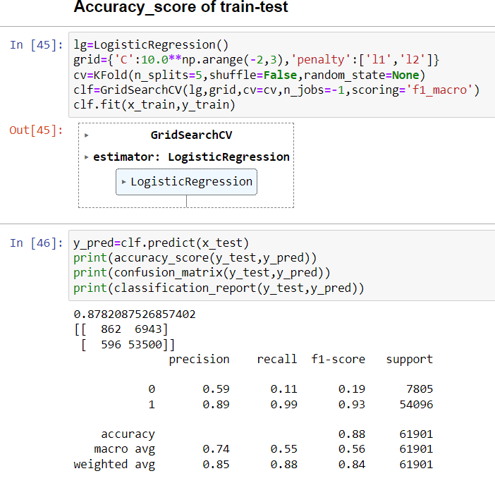
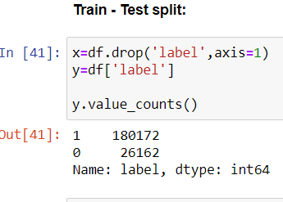
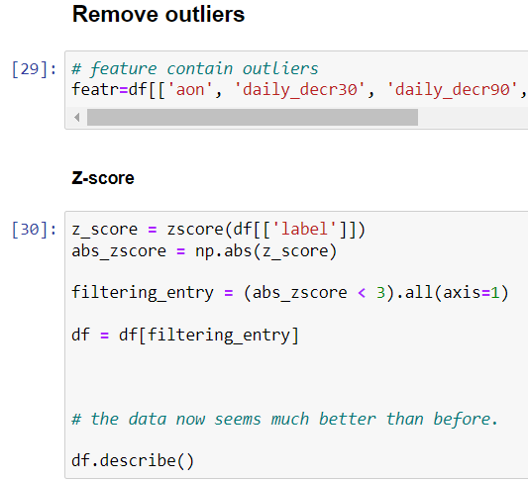

Slide 15
Machine Learning Models
The models used training and testing datasets are as followed:
Random Forest Classifier
Decision Tree Classifier
Ada Boost Classifier
Gradient Boosting Classifier
Bagging Classifier
XGB Classifier
SGD Classifier
For model implementations, the open-source Scikit-Learn package used.

Slide 16
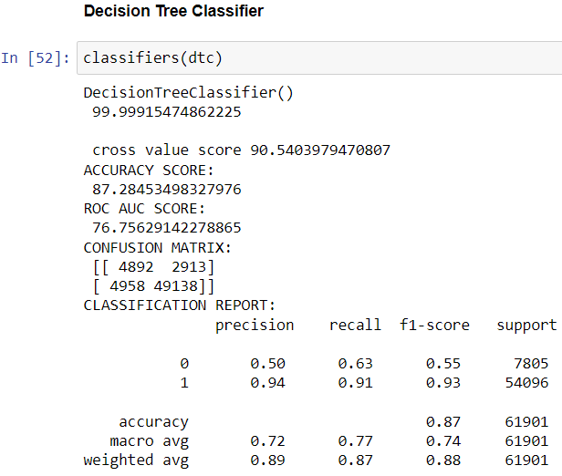
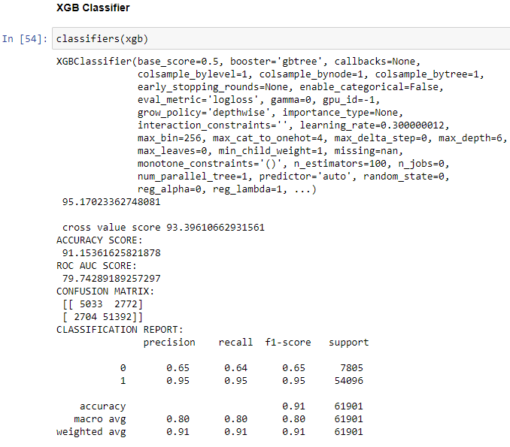
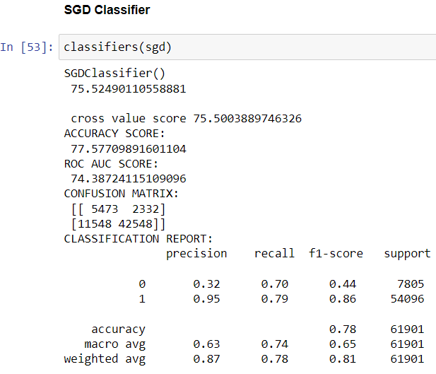

Slide 17
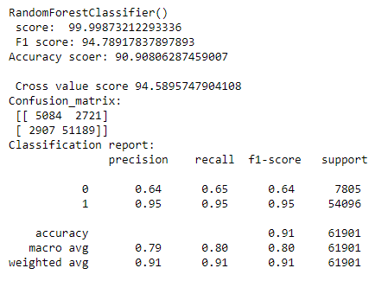
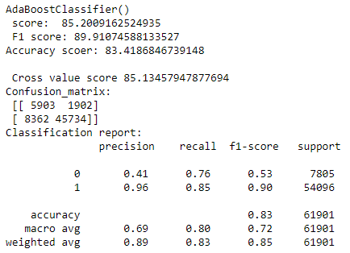
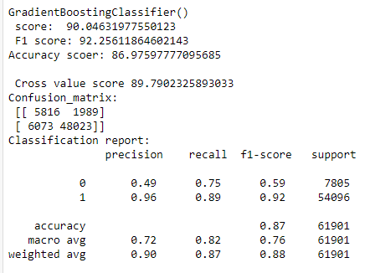
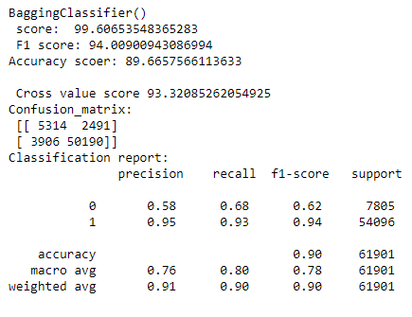

Slide 18
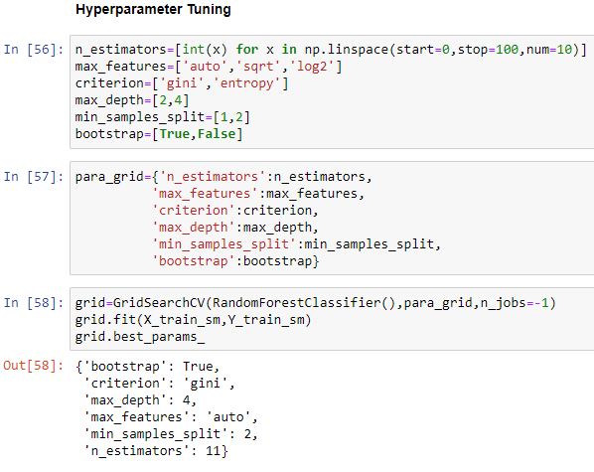
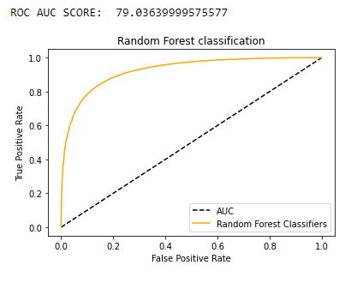
Hyper-parameter Tuning and ROC & AUC SCORE
ROC curves and AUCs are used to measure the quality of a classifier’s output; thus, they measure how correctly a classifier has been tuned. Movement along the ROC curve is typically a trade-off between the classifier’s sensitivity (true positive rate (TPR))

Slide 19
Conclusion

Slide 20
Key Findings and Conclusions of the Study
In this project report, evaluated individuals’ credit risk performance in a micro-finance environment using machine learning and deep learning techniques we have used machine learning algorithms to predict the micro credit defaulters. We have mentioned the step by step procedure to analyse the dataset and finding the correlation between the features. Thus we can select the features which are correlated to each other and are independent in nature.
These feature set were then given as an input to four algorithms and a hyper parameter tuning was done to the best model and the accuracy has been improved. Hence we calculated the performance of each model using different performance metrics and compared them based on these metrics. Then we have also saved the best model and predicted the label. It was good the the predicted and actual values were almost same.

Slide 21
Limitations of this work and Scope for Future Work
First draw back is the length of the dataset it is very huge and hard to handle.
Followed by more number of outliers and skewness these two will reduce our model accuracy.
Also, we have tried best to deal with outliers, skewness and zero values. So it looks quite good that we have achieved a accuracy of 91.32% even after dealing all these drawbacks.
Also, this study will not cover all Classification algorithms instead, it is focused on the chosen algorithm, starting from the basic ensemble techniques to the advanced ones.

Slide 22
Thank You

